Slide 1


2024
Understanding Finance Basics: Tasks, Actions and Reporting

Slide 2

Finance Basics
Review Annual Plan and Self Management Quiz
What are you listening for and to?
Foundations of Financial Management:
  Income Statement, Balance Sheet, Cash Management
Financial Strategy:
  Budget Forecasting
Financial Software
Next Steps
WESTCENTER.ORG/STARTUP-MENDO

Slide 3

Review
What did you learn about the balance of your business?
  Where are your comfort zones?
  What is hurting your business growth the most?
  What areas confused you?
How will you prioritize 2024?
  What needs to be developed?
  What needs to be maintained?
  What needs to be redirected?
Are you Self Managed?
  How did you score?
  What do you need?
  When will you know you are doing better?
WESTCENTER.ORG/STARTUP-MENDO

Slide 4
Are You Listening?
What does your business tell you?
Where is that information?
When should you respond?
What do you say?
The biggest communication problem in our society is we do not listen to understand. We are thinking of our reply. One of the sincerest forms of respect is to listen.
WESTCENTER.ORG/STARTUP-MENDO

Slide 5
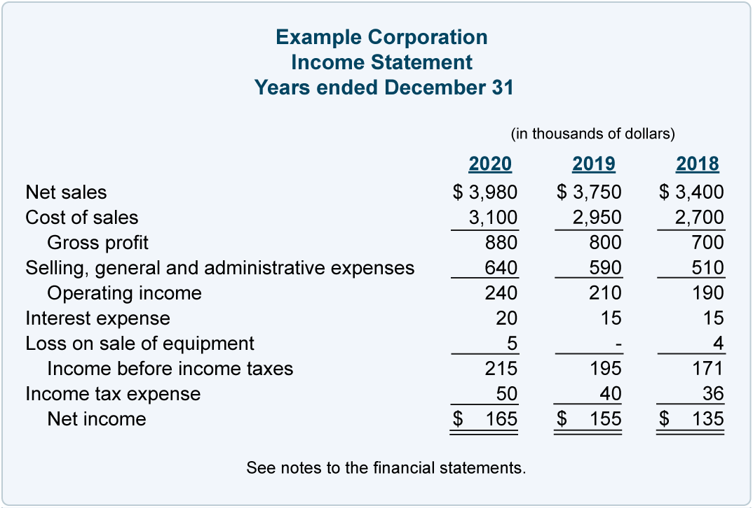


Income Statement
Your Profit and Loss Statement, often called an Income statement, shows you the performance of the company. It shows the monthly, quarterly and yearly activity the business is doing. The activity of your business is represented in income and expenses.
Performance and Profitability
Understand your performance through trends, actuals and percentages. Your profitability will be measured tangibly(Profit Margin) and intangibly(consistency).
Numerical Relationships
To deepen your understanding of the businesss and how to improve it, look at the relationship between your numbers. Does your revenue go up proportionally when you invest in marketing? When you are more present, do you see your payroll produce more? When you stay consistent with certain vendors, are your customers happier?
WESTCENTER.ORG/STARTUP-MENDO

Slide 6
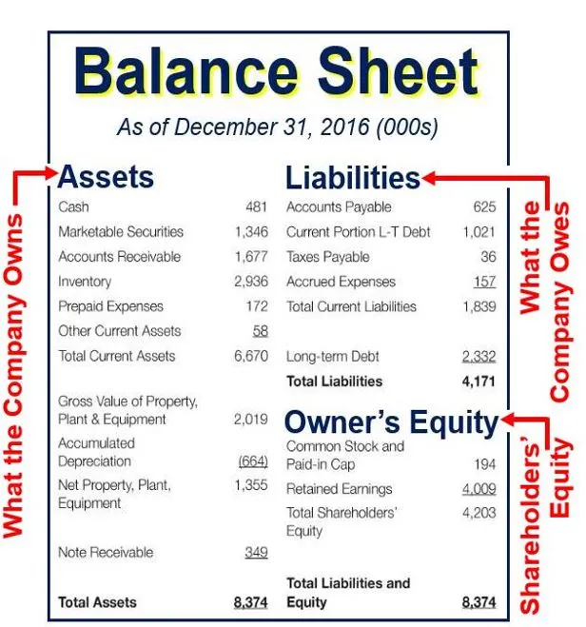


Balance Sheet
The balance sheet, on the other hand, tells what you own and what you owe. It discloses information about the book value and general health of your business.
Assets, Liabilities and Owners Equity
The health of the business is determined by what you own, what you owe and if the business has any net worth..or anything leftover after everything is bought and paid for.
Healthy business
By paying attention to your accounts receivable turns, your debt repayment trends and what you are saving, you will see if you are thriving or not able to get off life support.
WESTCENTER.ORG/STARTUP-MENDO

Slide 7
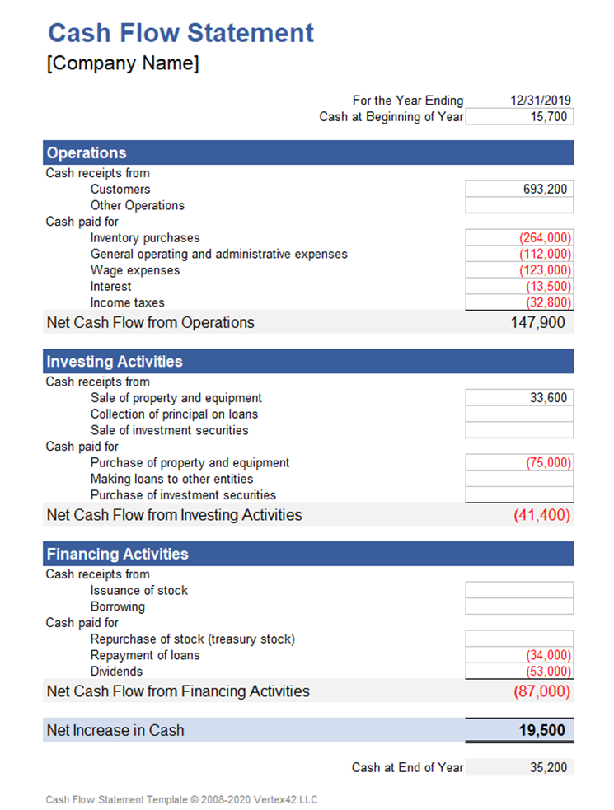


Cash Flow Statement
Your cash flow statement shows you the inflows and outflows of cash during a set time period of time. Businesses with many transactions will track cash flow more quickly, while businesses with less transactions will be longer.
Get In The Flow
Your income statement helps you figure out your profitability and your balance sheet helps you figure out your value, your cash statement helps you figure out your liquidity. That is, it tells you how much cash you have readily available that you can use to fund the ongoing or unexpected operations of your business.
Do you have enough?
Tracking cash flow will allow you to organize your accounts payable strategy to ensure you never draint he cash out of the business and that you don’t sit on too much. Cash makes more cash if used correctly.
WESTCENTER.ORG/STARTUP-MENDO

Slide 8
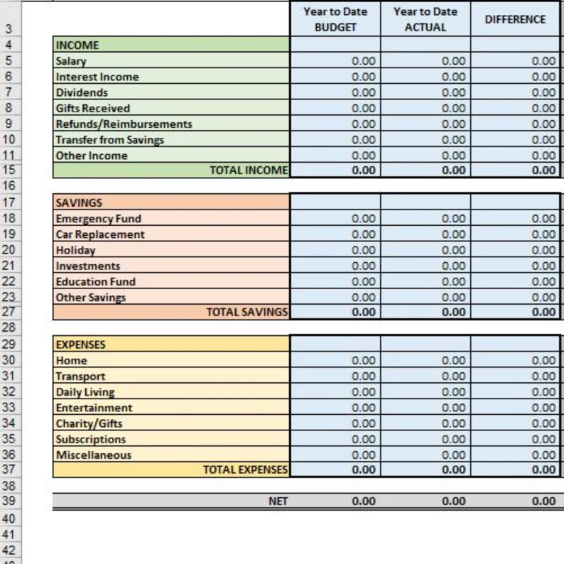
Budgeting For The Future
An Operational Budget forecasts your income and expenses in various categories on a monthly, quarterly, or annual basis.
Budgeting requires you to think about your basic objectives, policies, plans, systems, and resources on a regular basis.
It asks you to take this, coupled with the future goals you are trying to achieve and forecast a strategy for achieving those.
It enables you and your employees to undertake a coordinated, comprehensive effort to achieve your near-term objectives on the path toward your Vision.
Budgeting isn’t a one-time activity. You will go through planning and monitoring cycles on a regular basis. The steps below lay out the procedure that you will follow and explain who is responsible for each:
1. Set up the budget process.
2. Plan and forecast.
3. Monitor and report.
4. Review and manage.
WESTCENTER.ORG/STARTUP-MENDO

Slide 9


What Are You Using?
Consider Your Needs and your Experience.
Consider a Cloud Based Platform
Consider Your Budget.
Think about add on features.
Ask Your Accountant.
Systems Count
Using accounting software will help you get and stayed organized. It will also force finance systems in your business to be created. Finance systems can show up in every area of your business.
WESTCENTER.ORG/STARTUP-MENDO

Slide 10

Lead Your Future
“Money is one form of power. But what is more powerful is financial education. Money comes and goes, but if you have the education about how money works, you gain power over it and can begin building wealth. The reason positive thinking alone does not work is because most people went to school and never learned how money works, so they spend their lives working for money”.-R.Kiyosaki, Rich Dad, Poor Dad
WESTCENTER.ORG/STARTUP-MENDO

Slide 11

Next Steps
Confirm Your Income Statement and Balance Sheet are accurate.
Set up a written Cash Plan
Project a Q2 Budget Forecast
Learn Your Financial Software
WESTCENTER.ORG/STARTUP-MENDO

Slide 12




THANK YOU FOR BEING PART OF
2024
WESTCENTER.ORG/STARTUP-MENDO

