Slide 1

2024
Customers for Life: Customer Service and Client Retention

Slide 2


Agenda
Follow Up
What is Customer Service?
Tools for Building and Maintaining Excellent Customer Service
What is my brand and why should I care now?
Let’s Formalize: Client Retention Programs that Work
Next Steps
“It takes months to find a customer and seconds to lose them”
-Vince Lombardi
WESTCENTER.ORG/STARTUP-MENDO

Slide 3
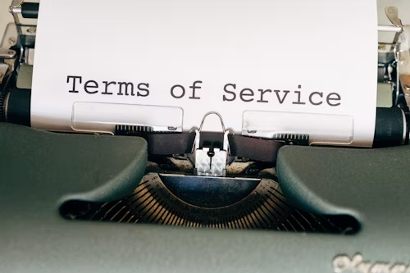
What is Customer Service?
The support you provide your customers and clients before, during and after they purchase your products or services that provides an easy and enjoyable experience working with your company and products and services.
What word do you associate with your Customer Service?
WESTCENTER.ORG/STARTUP-MENDO

Slide 4
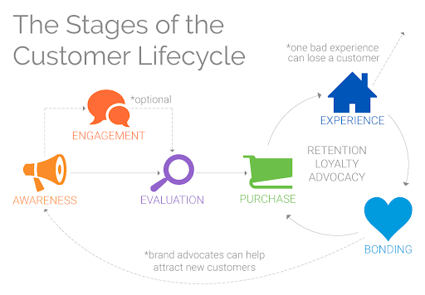


What do I do, when?
Customer service isn’t just about showing up nice all the time or answering the phone on the third ring. Sure, those activities may exist, however thoughtful customer service is an organized set of activities, strategically designed and delivered to meet specific stages of the customer lifecycle.
Business Relationships First
Remember that the relationship with your client is professional, not personal. This can be especially harder in a small community. Professional relationships are dominated by formality and boundaries, whereas personal relationships can be fluid, flexible and more nuanced based on emotions.
Systems and Structure Always
Systems and structure will support your relationships always being delivered in a professional manner. As you grow identifying the customer service processes and documenting them, will allow for you to teach others and eventually entrust others to deliver the same experience you do. Same time, all the time.
WESTCENTER.ORG/STARTUP-MENDO

Slide 5
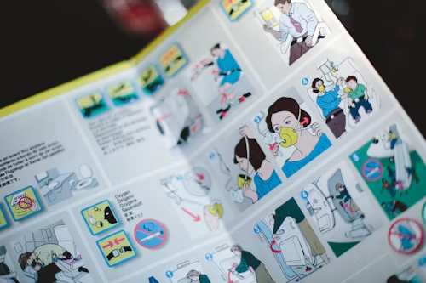
Documenting Workflow
Define the exact result you are trying to produce.
Document tools, people and necessities to execute.
Design Benchmarks.
Create Standards.
Always give tips and tricks.
A system is not complete until documented into a system action plan. When something can be done by someone else, without an owner or system creators constant interjection and interference
WESTCENTER.ORG/STARTUP-MENDO

Slide 6
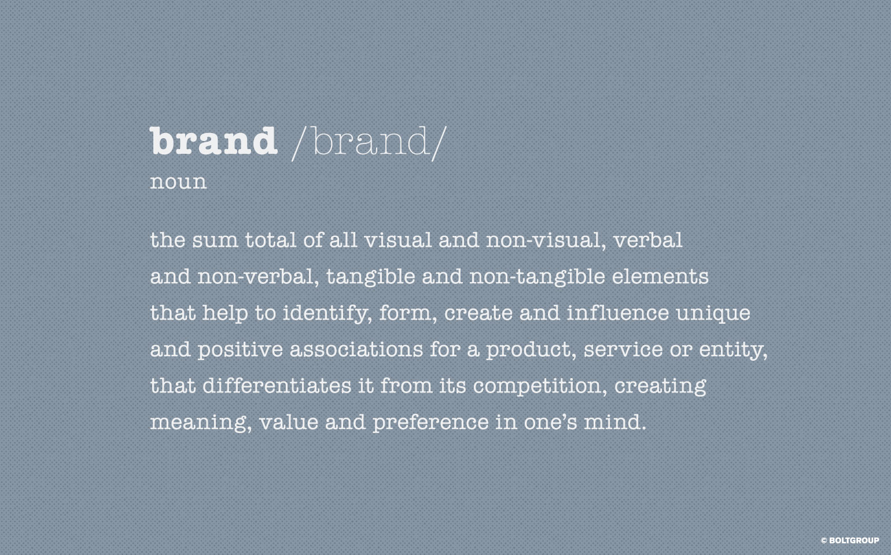
WESTCENTER.ORG/STARTUP-MENDO

Slide 7
Brand
Who Are You?
Your Values: What Do You Stand For?
Your Passion: What Do You Live For?
Your Purpose: What Do You Do?
WESTCENTER.ORG/STARTUP-MENDO

Slide 8

Who Are You?
Brand Commitment Statement
A statement, usually no more than a sentence or two that describes your life’s deepest passions, foundational values and strategic purpose. Just like a fingerprint, it is a definition of you that is deeply individualized and personal.
What Do You Want Your Customers To Say?
How Do You Want Your Customers To Feel?
Why Would Your Employees Work For You?
WESTCENTER.ORG/STARTUP-MENDO

Slide 9
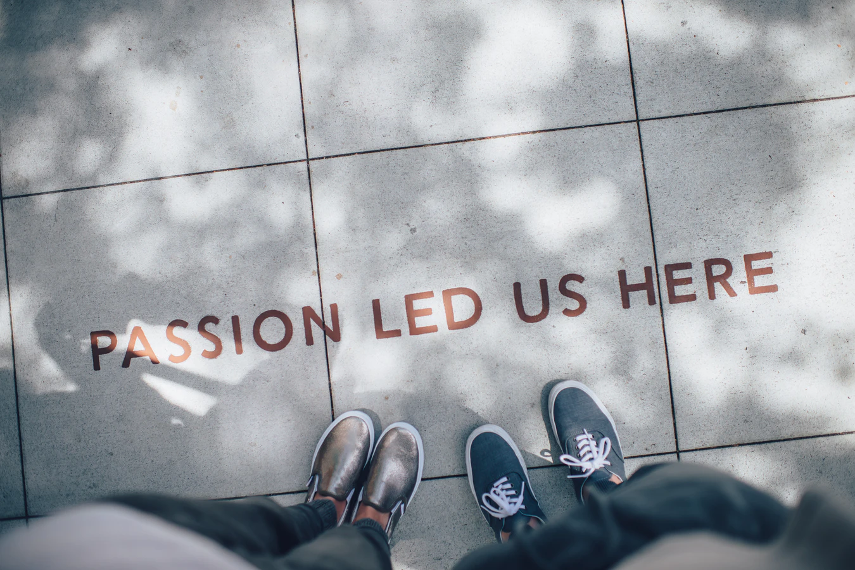
Brand Accountability
Branding is what people say about your business, when you have long left the room. However, if the brand does not attract the market found in marketing, it is pointless and futile. In essence, your entire company should be considered the branding department, that marketing is managing.
WESTCENTER.ORG/STARTUP-MENDO

Slide 10

WESTCENTER.ORG/STARTUP-MENDO

Slide 11

Before.
Contract or Agreement: A document that starts and binds the business relationship through outlining expectations, standards, timing and renumeration.
Project Scopes, Mind Maps and Calendars: Defined features, functions timelines and deadlines. Most systems are online, cloud based and is accessible and updated, by multi users. Basecamp, Asana and Zoho Project are excellent project management tools.
What do you use, say and imply to start the relationship?
WESTCENTER.ORG/STARTUP-MENDO

Slide 12

During.
Information: Keeping project plans updated, you will have access to when, how and why you worked on a project or relationship. Having accurate data will allow you to understand where you stay on track or not.
Management: At the end of every week, month and quarter, audit the project and make course corrections necessary to finish on or before schedule.
Communication: If project is not on track, communicate that to whomever may be impacted.
How do you like to be treated?
WESTCENTER.ORG/STARTUP-MENDO

Slide 13

After.
Check Ins and Follow Ups
Customer Surveys
Reminders and Updates
Easier Transaction Process
Would they refer you?
WESTCENTER.ORG/STARTUP-MENDO

Slide 14
How do I Say It?
Inspire: “I am calling to give you an update on a recent change I had to make to one of our deadline dates.”
Educate: “Unfortunately, the edits took longer than I realized. While that is not going to cost you more, it will push our deadline out by 2 days. My apologies for not assessing this better before our project started.”
Implementation: “I have created space in my calendar by (Pushing another project out, working nights and weekends, not sleeping) and if I can move anything else to get this done on time, I will.”
Continuous Improvement: “I don’t want you to worry at all about this being finished by XXX. Would you like me to check in more often than I have been?”
WESTCENTER.ORG/STARTUP-MENDO

Slide 15
Customer Retention Programs
Customer retention programs are strategies and initiatives designed by businesses to keep existing customers engaged, satisfied, and loyal to their brand over time. These programs aim to reduce customer churn (the rate at which customers stop doing business with a company) by fostering long-term relationships with customers.
Key components of customer retention programs may include:
Loyalty programs: These programs reward customers for repeat purchases or engagement with the brand. This could involve earning points for every purchase, which can then be redeemed for discounts, free products, or other rewards.
Personalized communication: Businesses use data and analytics to understand their customers better and tailor communication and offers to their preferences and behaviors. Personalized emails, offers, and recommendations can make customers feel valued and understood.
Exceptional customer service: Providing excellent customer service is crucial for retaining customers. This includes resolving issues quickly and efficiently, being responsive to customer inquiries and feedback, and making the overall experience pleasant and hassle-free.
Exclusive offers and incentives: Offering exclusive deals, discounts, or early access to new products/services can incentivize customers to stay loyal to the brand.
Regular engagement: Keeping customers engaged through various channels such as social media, email newsletters, and events helps maintain their interest in the brand and strengthens the relationship.
Feedback and improvement: Actively seeking feedback from customers and using it to improve products, services, and overall customer experience demonstrates a commitment to meeting their needs and preferences.
WESTCENTER.ORG/STARTUP-MENDO

Slide 16
Next Steps:
System Template
Brand Statement

Slide 17




THANK YOU FOR BEING PART OF
2024
WESTCENTER.ORG/STARTUP-MENDO

